Slide 1


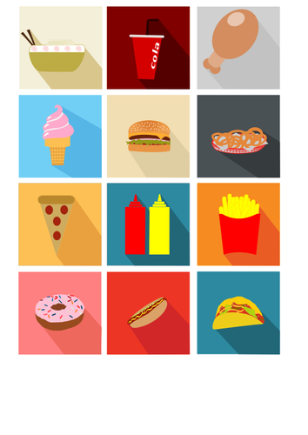
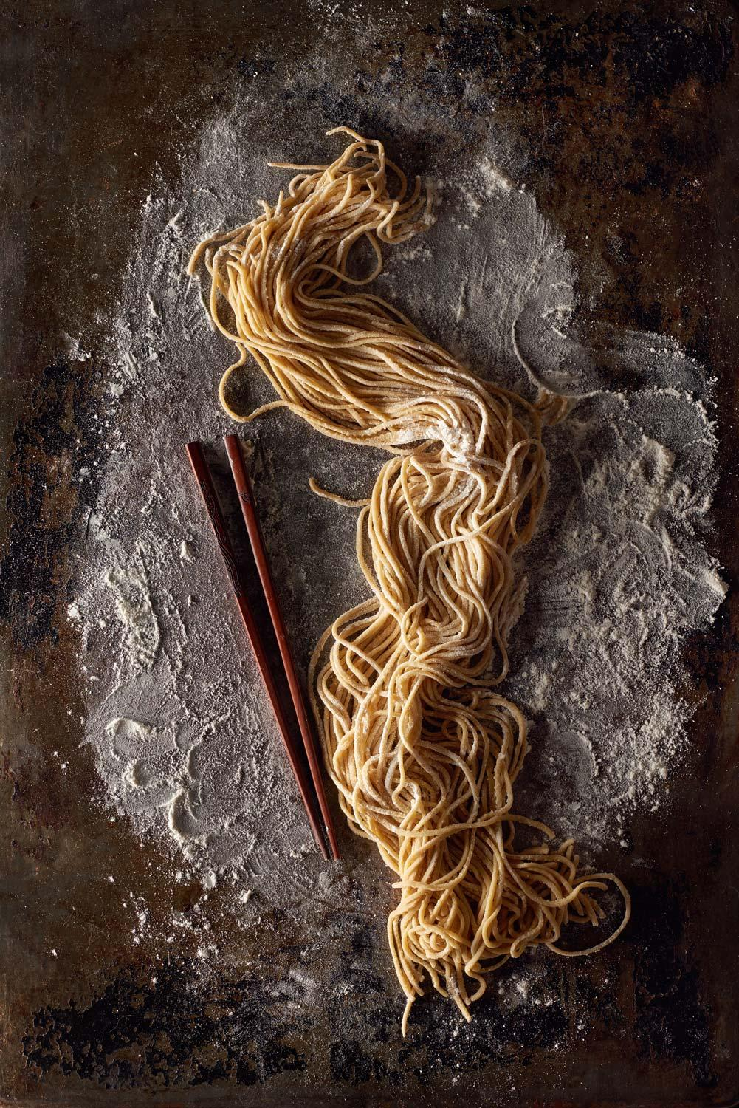

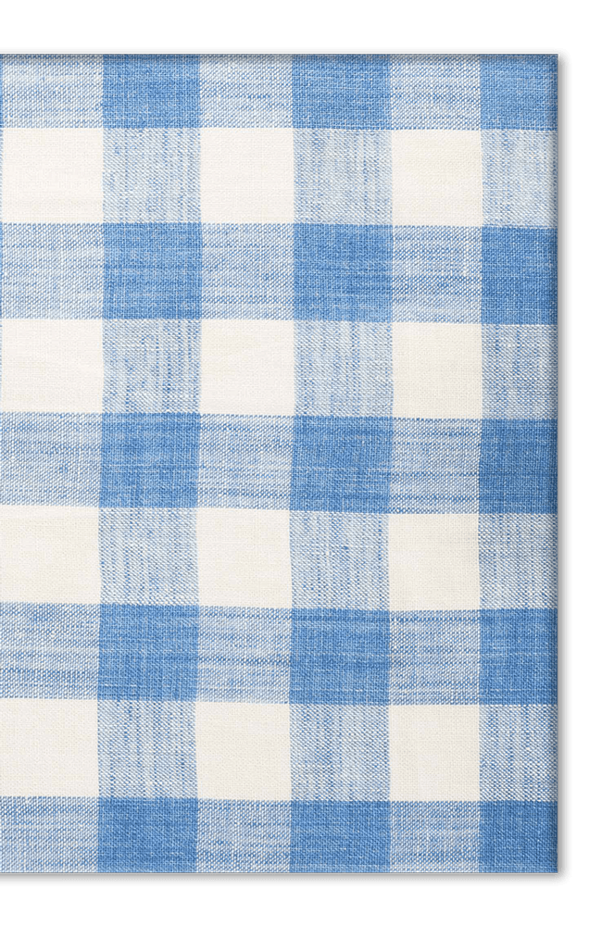
Food
Reactions
By:
Michael M.
Daniel M.
Anthony H.
Alexander G.
Antoine R.
Lara B.

Slide 2

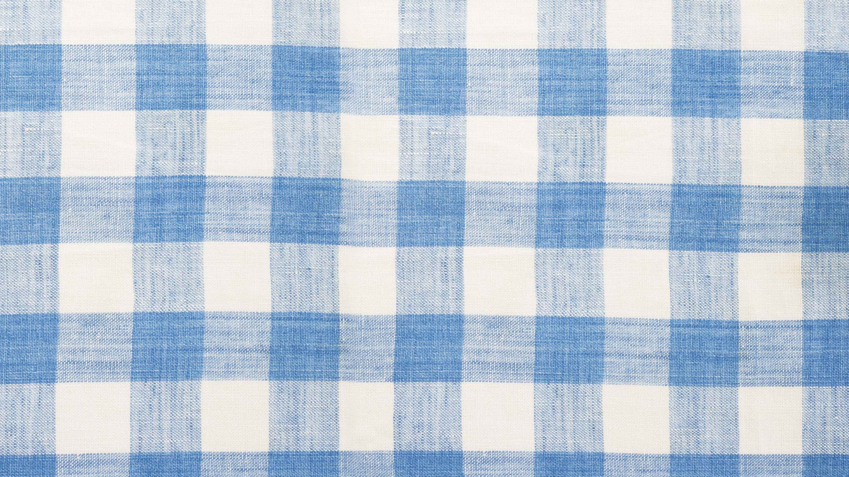
?
What is the most common type of food reactions?
Which food industries are associated with food reactions, and how do they affect different age groups?
Which food brands are commonly associated with food reactions?
What are the health outcomes of food reactions, and did their effect change over the past 20 years?

Slide 3

Definition
Adverse Food reaction: “any abnormal clinical response that occurs following ingestion of a food or food component.”

Slide 4

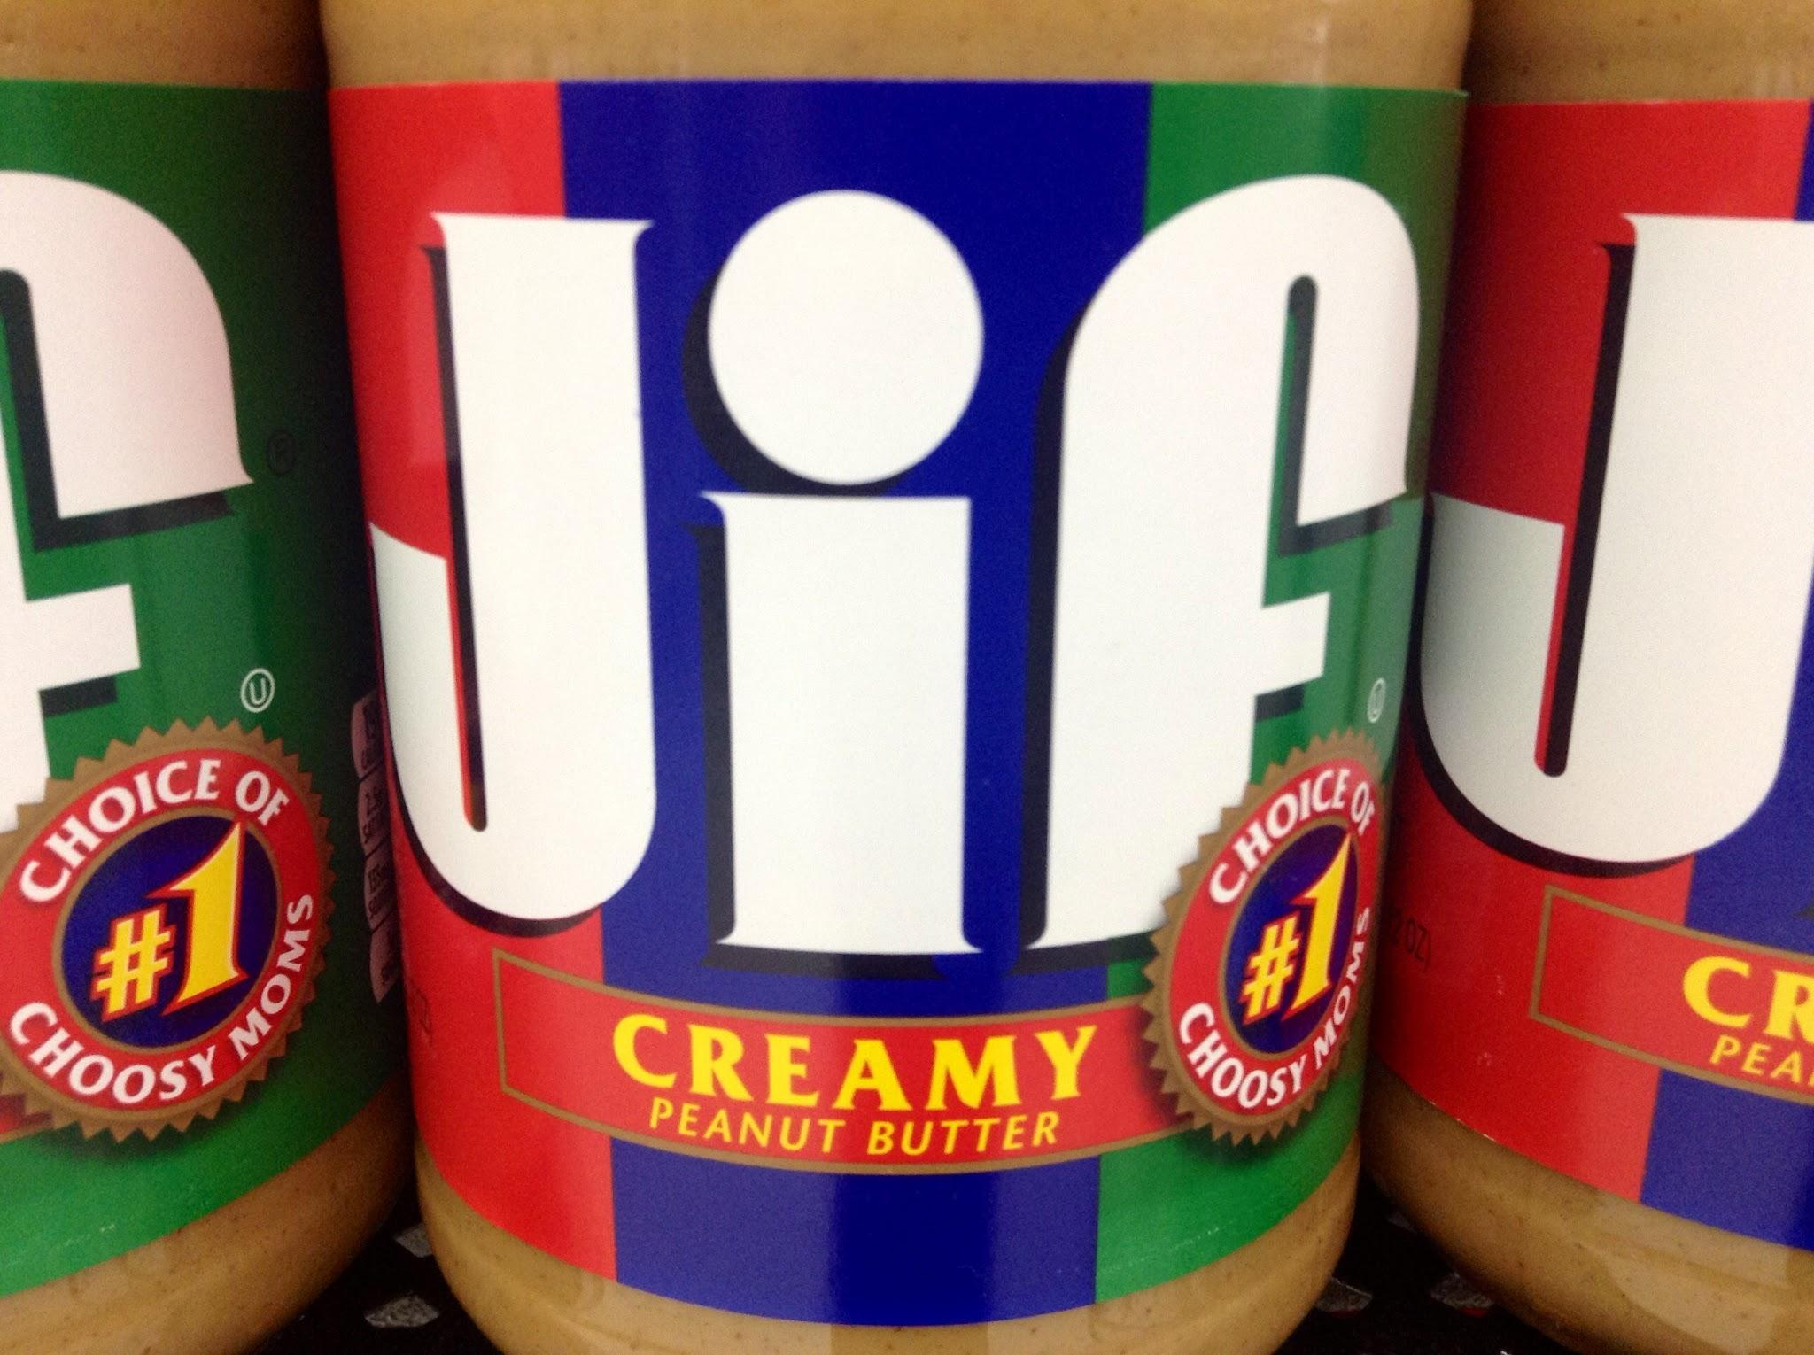
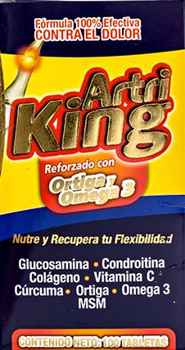
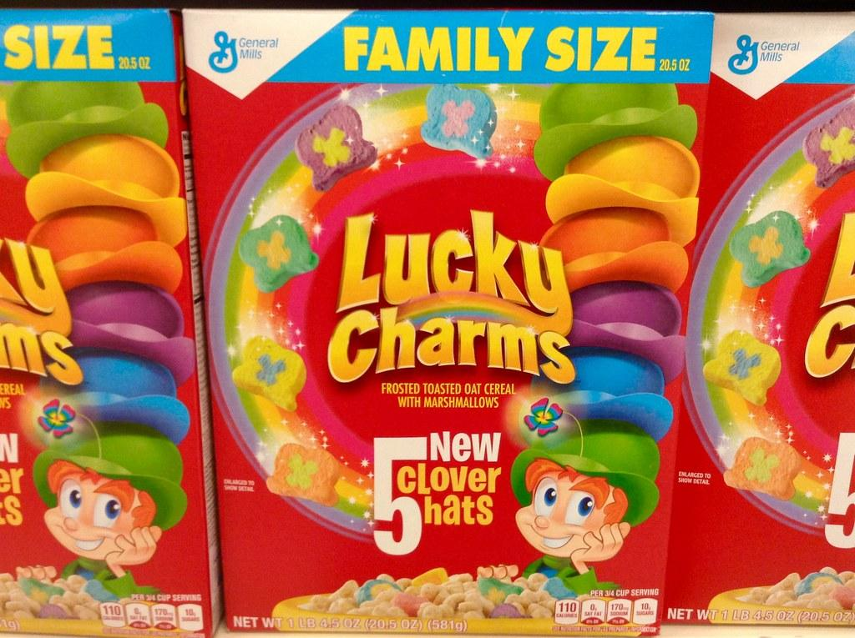
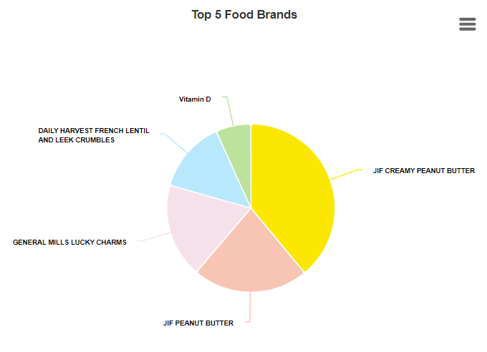
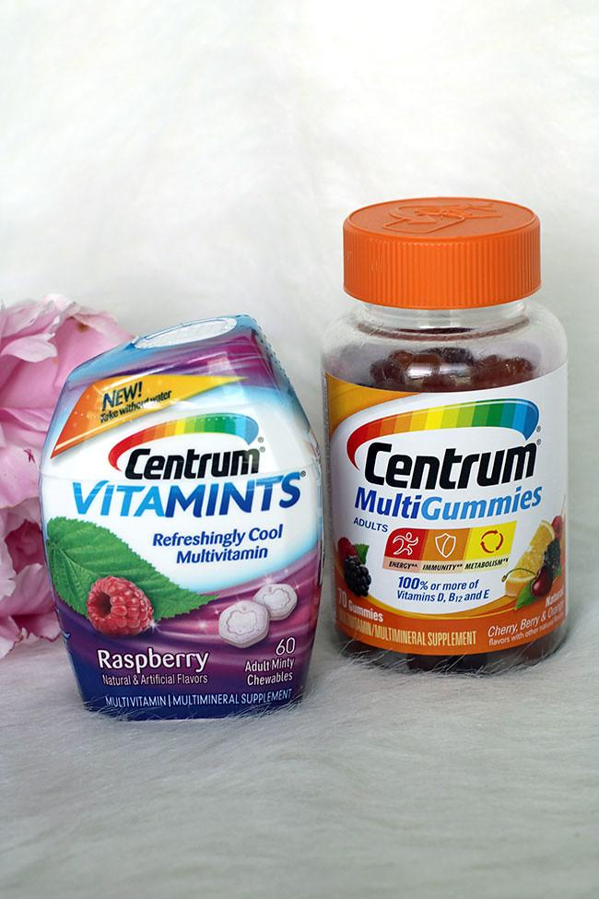
Top Food Brands associated with Food Reactions
2022:
JIF Creamy Peanut Butter
General Mills Lucky Charms Cereal
Daily Harvest French Lentil and Leek Crumbles
2023:
Multivitamins
Biotin
Fish oil
Vitamin D, B12, and C
Artri King

Slide 5

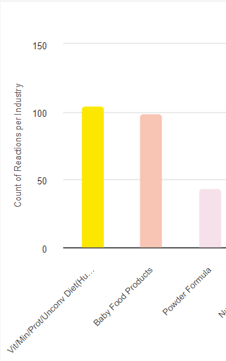
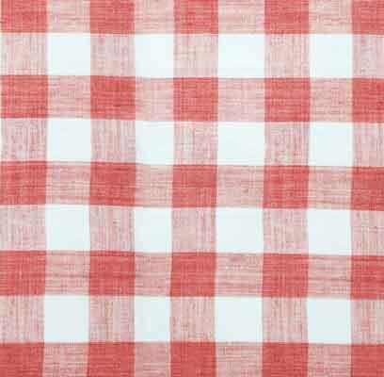
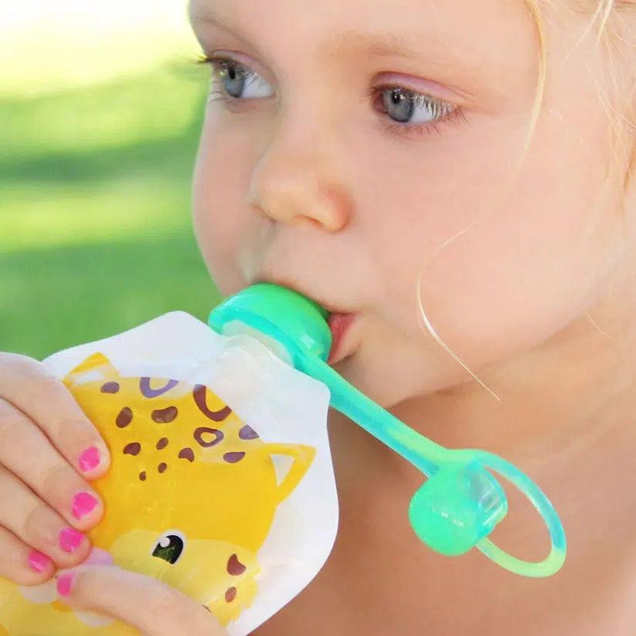
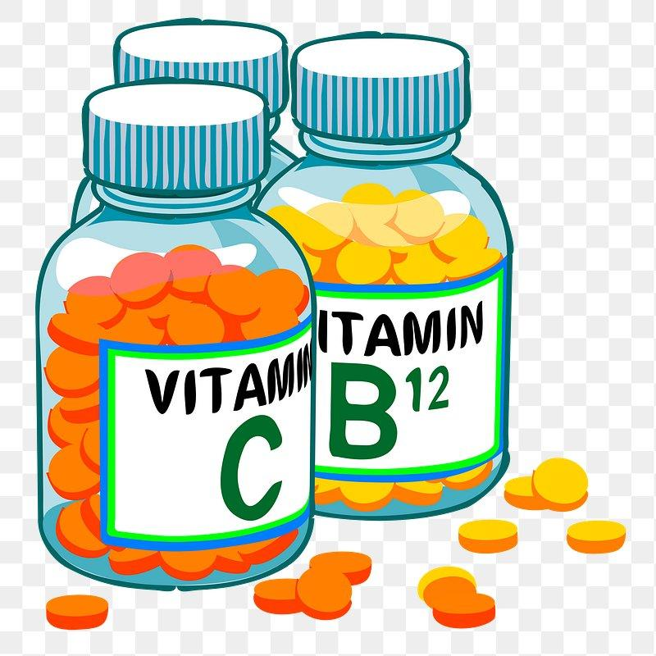
1-11 years old:
Vitamins/Minerals/Protein Supplements
Baby Food Products
Powder Formula
12 years old and above:
Vitamin/Minerals/Protein Supplements
Bakery/Dough/Icing
Nuts/Edible Seeds
Soft Drinks
Food Reactions and Consumer’s Age

Slide 6
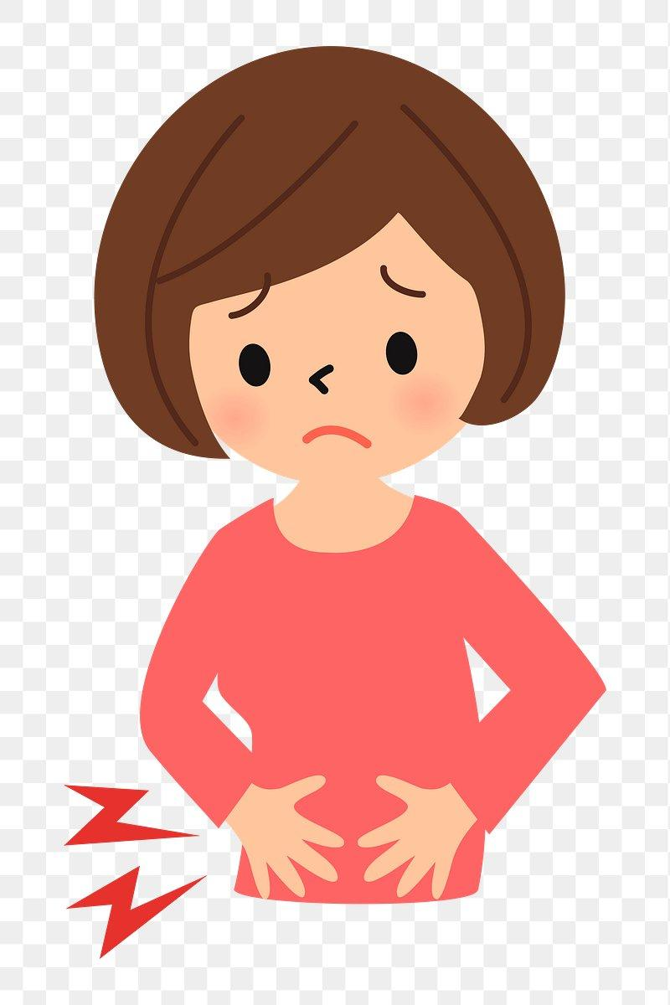
Diarrhea is the most common food reaction
Diarrhea from Food by Gender
Females
get more diarrhea from:
Bakery products
Cereals
Cheese
Baby food products
Chocolate
Meal replacements
Vitamins/Minerals
Males
get more diarrhea from:
Alcoholic beverages
Gums and candy
Eggs
Soft drinks
Dataset contains more female consumers that males

Slide 7
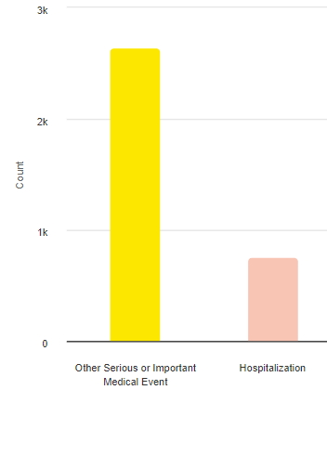
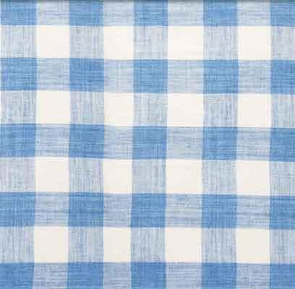
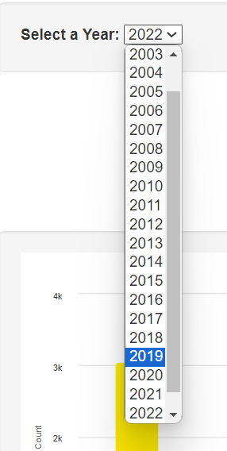
Hospitalization
Death
Other serious medical event
Visit to the doctor’s office
Visit to the ER
Disability
Death used to be in the top 5 common outcomes of food reactions until 2019
Outcomes

Slide 8
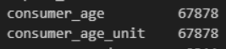

Making Null values palatable
Dataset has over 20,7000 records
Null or missing years: over 64,000 records!
most null years were from the 1900s.
limited the year selection from 2001 till 2023. Set null values to a “-”.
Null or NaN age: over 67,000 records!
changed the age dtype into integers, rounded up to whole numbers. Set the remaining null ages to “0”. Used age in only one query.
No records or entries were deleted.
Dataset was huge. Let us to comfortably query the rest of the attributes.

Slide 9
Food Reactions
Reactions
Consumers
Product
Outcome
Reaction Type
Brands
Industry Names
Outcome Type
Role
2
Level of normalization

Slide 10
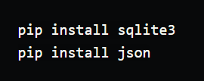
Dataset was in a JSON file.
Housed in a SQLite database.
Used pure SQL to query the database.
Created 5 flask API endpoints.
Used Highcharts JS library to create 4 visualizations.
Used Javascript + html to create 2 dropdown menus and one range slider
2 charts are dynamically updated using 2 options at once!
Charts can be downloaded in different image file.
Python libraries to import JSON file into SQLite tables

Slide 11
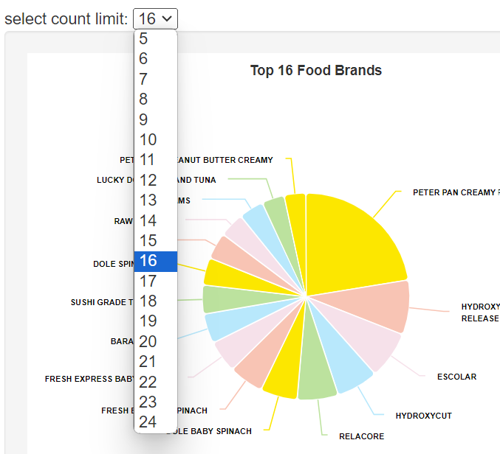
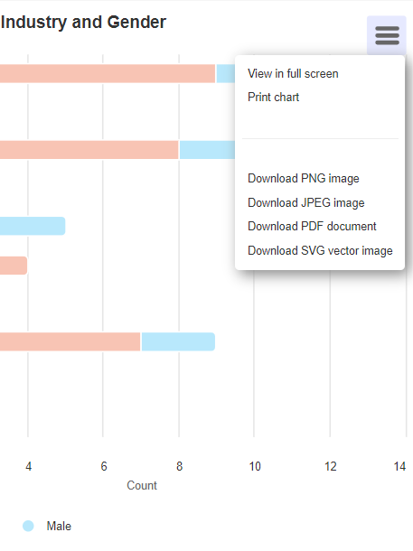


Slide 12
References
[FDA Official Website]
[Pandas Documentation]
[Python Documentation]
[Highchart Documentation]
[ChatGPT Documentation]
[PowerPoint Documentation]
[SQLite Documentation]
[Flask Documentation]
https://pandas.pydata.org/pandas-docs/stable/reference/api/pandas.json_normalize.html : https://github.com/DataSteph/Opioid-Analysis-/tree/144fbf28c2bab32eaa55e615d96306b1328cadd5/FDAApi.m
d : https//stackoverflow.com/questions/21104592/json-to-pandas-dataframe : https://www.datasciencelearner.com/python-exceptions/importerror/importerror-cannot-import-name-json-normalize-from-pandas/ : https://min-api.cryptocompare.com/data/histoday?fsym=
https://www.sciencedirect.com/topics/agricultural-and-biological-sciences/adverse-food-reaction#:~:text=An%20adverse%20food%20reaction%20is,Canine%20and%20Feline%20Gastroenterology%2C%202013
Dataset source: https://download.open.fda.gov/food/enforcement/food-enforcement-0001-of-0001.json.zip

